Slide 1


Towards Educational Video Games with Enhanced Virtual Players
Boyan Bontchev, Dessislava Vassileva, Velin Avramov, and Dimitar Manchev
Faculty of Mathematics and Informatics,
Sofia University “St. Kliment Ohridski”, Sofia, Bulgaria
CISTI’2025
Lisbon, Portugal
June 16-19, 2025

Slide 2
Agenda
Educational video games
Intelligent player-centric tailoring of digital games for education
Virtual players or non-playable characters (NPC)
Roles of NPCs in educational video games
NPCs in educational video mazes
Automatic generation of personalized and adapted SG
Maze games with complex NPC with adaptive behavior
Workflow of dynamic game adaptation control
Results
Conclusion

Slide 3
Educational video games
Serious/applied video games for education purposes
Features:
Engagement & Motivation – interactive gameplay increases student interest and participation.
Personalized Learning – AI-driven adaptations cater to individual learning styles.
Critical Thinking & Problem-Solving – Games foster decision-making skills and strategic thinking.
Language & STEM & Arts & Soft Skills Development – integrates science, technology, engineering, and mathematics with creativity and collaboration.
Immersive Learning Experiences – virtual environments enhance concept retention and application.
💡 “Learning is most effective when it’s fun and interactive!” – Dr. Susan Curtiss

Slide 4
Intelligent Player-Centric Tailoring of Digital Games for Education
Player-Centric Digital Games
Game design, generation, and analysis tools
Recognizing and tracking player emotions & outcomes
NPC with adaptive behavior
Personalized content based on the player model
AI for creating customized games
Dynamic difficulty adjustment

Slide 5

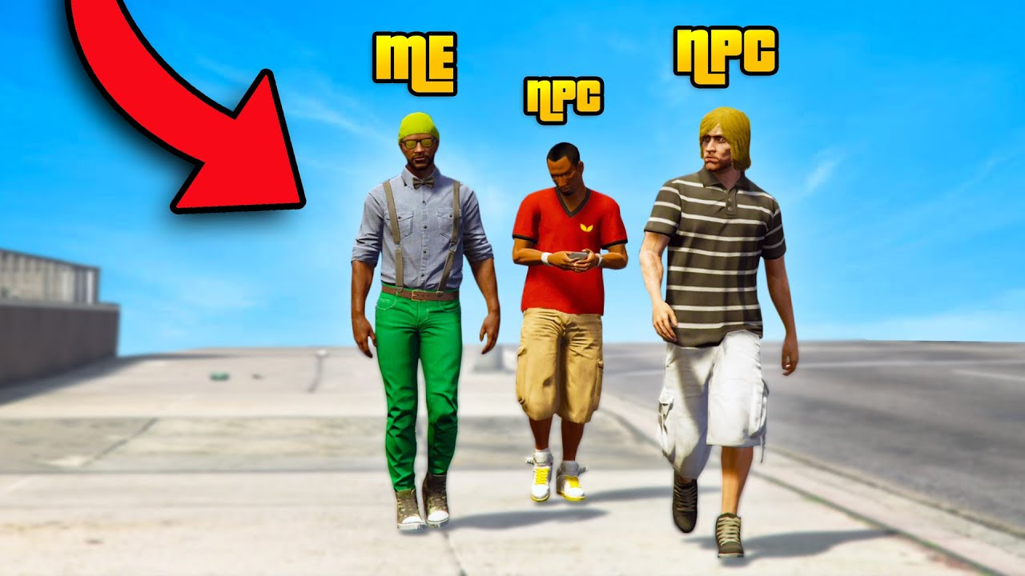
Virtual players or non-playable characters (NPCs)
Virtual players/characters (so called NPCs) are an important element in educational video games, as they help create a more engaging, realistic, and effective learning environment for players.
They are an integral part of most modern video games, as they add depth, realism, and opportunities for interaction

Slide 6
Roles of NPCs in educational video games
A teaching assistant who provides information and feedback to the player
Testing and assessing the knowledge and skills of the real player
A rival or adversary with whom the real player competes – e.g., through competitive gameplay with NPCs representing different historical civilizations in “Civilization VI” or NPCs embodying historical figures in Assassin's Creed: Discovery Tour
A partner with whom the player interacts to achieve a specific goal, for example to simulate realistic social interactions
A virtual character that helps to create a believable and engaging game environment in order to improve user experience and engagement in different contexts – balance between believability and effectiveness depends on the context.

Slide 7
NPCs in educational video mazes
Educational video maze games combine interactive learning with problem-solving challenges. They motivate players to explore theoretical concepts while navigating through engaging mazes and challenges.
Research and implementation of educational video maze games have demonstrated their effectiveness in adaptive learning, where players navigate through a structured environment while interacting with didactic mini-games, NPCs (non-player characters), and intelligent agents
The Video Maze Generator, designed for the automatic generation of educational games, provides a framework for creating such games from non-IT people.
The platform allows teachers to incorporate text-based challenges, visual storytelling, and AI-driven NPC interactions.

Slide 8
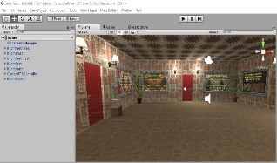
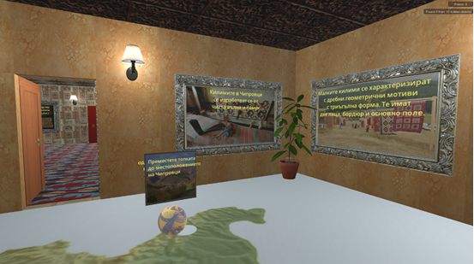
Automatic generation of personalized & adapted games
Automatic
game generation
Maze Builder
Maze Editor
Online games
Unity3D API
Unity3D game engine (browser plugin)
Connectivity Editor
Generated XML + multi- media
content
Unity3D Editor
3D maze
Property Editor
Textual content
Didactic game tasks
Graphics
Personalization and adaptation
Audio content
Metadata (XSD)
Intelligent Q&A agents
Didactic tasks
Virtual players
Virtual players
Note: dashed modules are under development

Slide 9
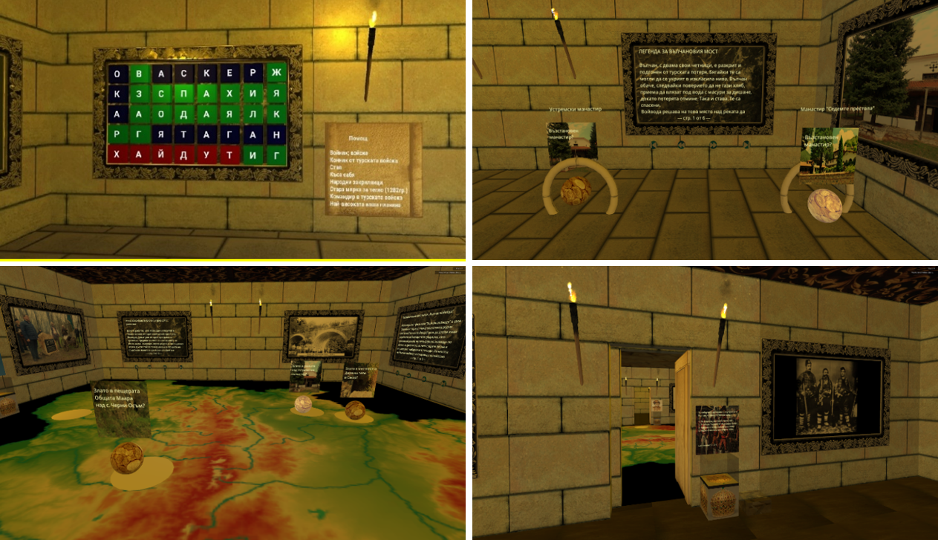
Screenshots of some generated video games
The Dynasty of Asenevtsi
The Heritage of Valchan Voivode
Let Us Save Venice
Climate Heritage Vulnerability Game
Climate Heritage Impact Game
Climate Heritage Adaptation Game

Slide 10
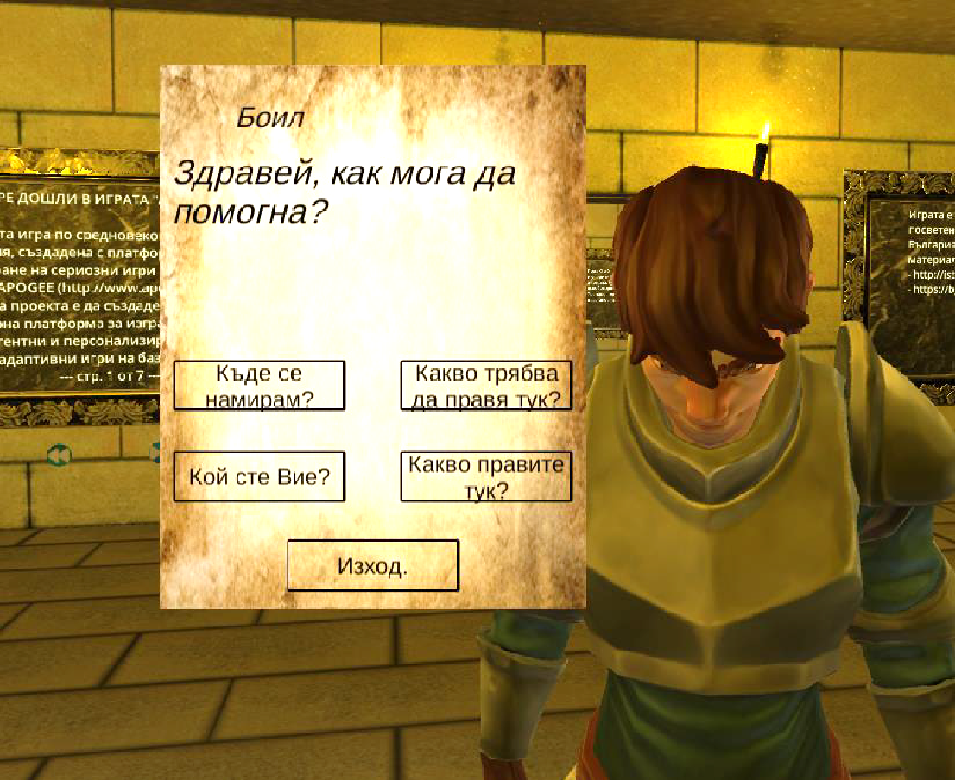
Fixed tree-based dialog with a simple NPC
For intelligent, complex virtual players (i.e., NPCs):
the player can ask free-form questions,
which are sent over the Internet to an intelligent conversational agent.

Slide 11
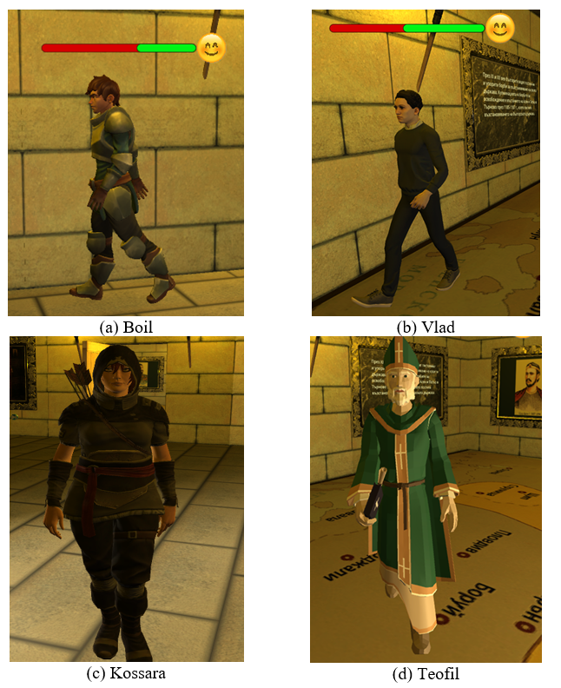

Maze games with complex NPC with adaptive behavior
The NPCs emotional state constantly changes based on the actions of the real player.
The avatars (a) and (b) illustrate the emotional state of the virtual player.
A progress bar, colored green and red, indicates the transition toward a new emotional state.
The red color represents a shift toward a worse emotional state, while green indicates an improvement.

Slide 12
Workflow of dynamic game adaptation control
Gameplay Registration
Playing
Style Self-Report
Game Outcomes and Efficiency
Analysis
Emotion State Registration
Control
Visualization
Data Clustering
Real-Time
Player
Feedback
through an
Adaptation
Control Panel
Game Adaptation
Procedures
DDA and
NPC Behavior
EDA/BVP Measurement
Data Classification
Neural Network
Facial Expressions (Video Stream)
(Bontchev et al., 2021)

Slide 13
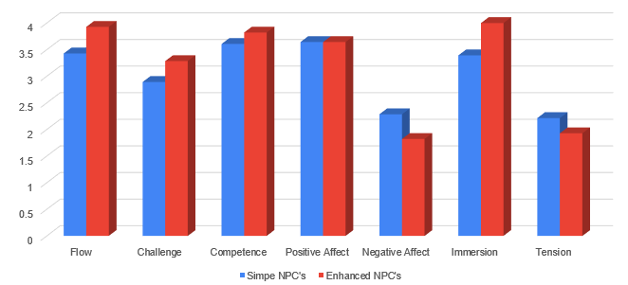
Results
Simple and enhanced NPCs were evaluated by practical gaming sessions with the online game.
After the game session, players filled an online version of GEQ for evaluating each component of game experience, namely flow, challenge, competence, positive and negative affect, immersion, and tension.
T-tests proved statistically significant differences in mean values between simple and enhanced NPCs for immersion (p<0.0001), flow and negative affect (p<0.01), and for challenge and tension (p<0.05)
Cohen’s d (effect size) is between 0.48 and 0.15 (from intermediate up to small)

Slide 14
Challenges
Limited intelligence and realism of NPCs – in some cases NPCs demonstrate limited communication skills, decision-making, and realistic behavior. NPCs approach but don't quite achieve human-like behavior. One solution for this is to incorporate in the educational games advanced machine learning and natural language processing techniques to improve NPC intelligence and natural human behaviors
Limited personalized experience for players – the reason for it is that NPCs often remain static and do not individually respond to the player’s actions. This can be resolved by implementing adaptive systems that adjust NPC behavior based on the player’s profile and actions
Lack of integration of NPCs with educational content – often NPCs are not effectively tied to the learning objectives of the game. One solution can be to keep close collaboration between game developers and educational content experts to ensure the correct alignment between game mechanics and educational objectives

Slide 15
Conclusions – future works
Enhancing NPC intelligence – implementing more advanced machine learning models and natural language processing to allow NPCs to conduct realistic dialogue and decision-making;
Expanding emotional adaptation – improving the emotion recognition models to allow NPC reactions based on player behavior or physiological parameters;
Developing more dynamic narratives – incorporating procedurally generated storylines that adapt to player choices, increasing engagement;
Optimizing game accessibility – by incorporating support for different learning styles, disabilities, and multilingual features;
Conducting large-scale user studies - evaluating the effectiveness of adaptive educational maze games through empirical research involving diverse student populations and measuring their long-term impact on learning outcomes.

Slide 16

Thank you for your attention!
Contacts:
bbontchev@fmi.uni-sofia.bg
ddessy@gmai.com
valentina.terzieva@iict.bas.bg
Acknowledgement:
The research that led to these results was funded under the MOTIVATE project, funded by the Scientific Research Fund, Grant Agreement No. KP-06-N85/2 of 12.05.2024.
Q & A

